Slide 1
Forecasting Day Ahead Electricity Prices in Germany
Arda Burak Mamur
E.ON Future Lab

Slide 2
Introduction
Goal : Price Prediction
Electricity prices follows patterns over daily, weekly, and seasonal timeframes
Machine learning techniques can be utilized to predict these patterns
Dataset
Electricity (price, load and generation )
Weather

Slide 3
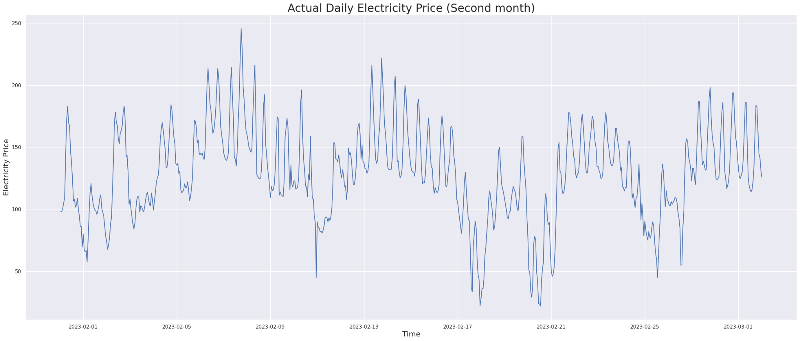
How patterns look like ?

Slide 4
How do we utilize those patterns to predict something in future ?
Statistical Machine Learning Models
LightGBM :
LightGBM stands for Light Gradient Boosting Machine. It's a powerful machine learning tool used for a variety of tasks like classification, regression, and ranking. Its main advantages are speed and efficiency.
To understand LightGBM, let's start with an analogy. Imagine you're trying to teach a computer to recognize cats in photos. You can start by showing the computer a lot of pictures and telling it which ones have cats. This is traditional machine learning.
But if the computer is wrong, how can it improve? Here's where LightGBM comes in. It follows a technique called "Gradient Boosting". This is like the computer asking for help every time it's wrong and making adjustments based on the feedback.
In other words, LightGBM is like an efficient and quick learner which learns from its mistakes!

Slide 5
Why use LightGBM ?
LightGBM is unique because it's not just about learning from mistakes, but also about learning efficiently. It uses a strategy of focusing on the more complex and error-prone pictures (or 'data points' in machine learning terms) rather than looking at all pictures equally.
Imagine a class where a teacher pays more attention to students who struggle the most, ensuring they improve. This is what LightGBM does with your data!
It's also known for working well with large datasets, meaning it can handle a lot of pictures of cats without getting overwhelmed. Plus, it's very fast, so the computer can learn to spot cats quickly.

Slide 6
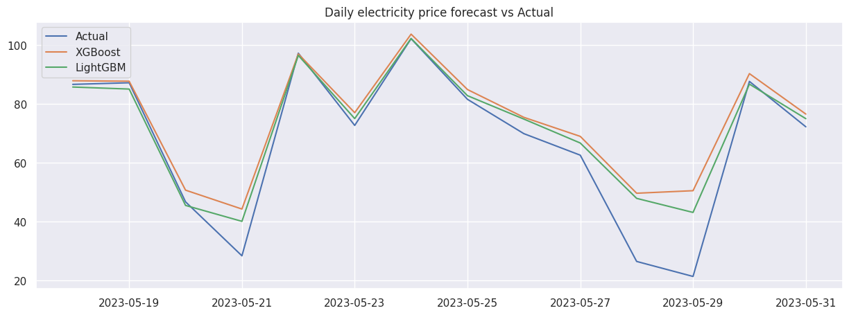
Results

